Slide 1

Screentime Study
Joleen Meuleners

Slide 2
Question:
Does the day of the week affect how much I am on my phone?
Does it depend on if I work or not?

Slide 3
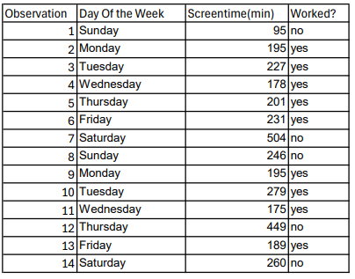
Data
14 observations
Variables
Worked?
Yes or No?
ScreenTime
Recorded with Digital Wellbeing

Slide 4
Hypothesis Testing
Claim:
The mean screentime is less on days at work than days not at work
Variables:
Dependant: screentime
Independent: worked -> yes or no

Slide 5
Hypothesis Testing
Step one:
Null Hypothesis
Screen Time on work days and days off are equal
Alternative Hypothesis
Screen Time on work days is less than off days
Step two:
Use t-test

Slide 6
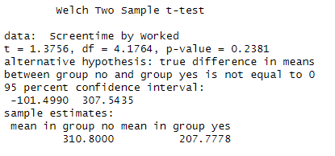
Hypothesis Testing
Step three:
Test Statistic:
P-value: 0.2381
T-Test:
Step four:
Using significance level 0.05, fail to reject the null hypothesis

Slide 7
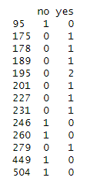
Conclusion
Since the p-value, 0.2381 is greater than 0.05, we fail to reject the null hypothesis. There is not enough evidence to support the claim that the mean Screentime on days not at work is more than the mean Screentime on days at work.

Slide 8
GitHub
Jmeuleners/Screentime-Study

